Slide 1

HR Analytics Dashboard

Slide 2

Agenda
PROJECT OVERVIEW
DATASET INFORMATION
KPIs
HIRING TREND BY YEAR
GENDER DISTRIBUTION
EMPLOYEES BY STATE
EMPLOYEES BY DEPARTMENT
EMPLOYEES BY RACE
RECOMMENDATION
CONCLUSION

Slide 3
PROJECT OVERVIEW
Objective:
To analyze employee data and generate actionable HR insights to support strategic workforce decisions.
Key Goals:
Understand workforce distribution by gender, department, and locationIdentify hiring patterns and employee demographicsDerive insights to improve diversity, workforce planning, and retention

Slide 4
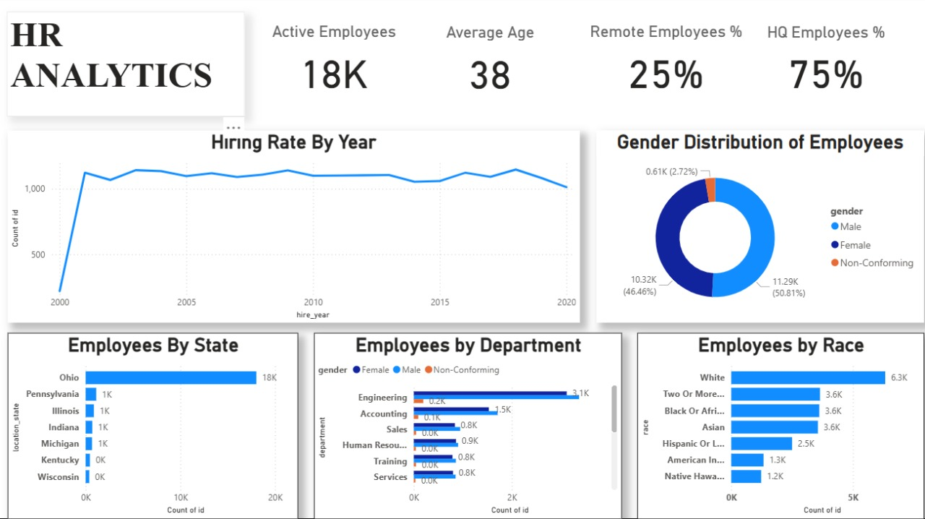

Slide 5
DATASET INFORMATION
Source:
HR Analytics database provided by DataMitesTable
Name:
HRTotal Records: ~21K Employees
Main Attributes:
Employee , ID, Gender, Department, Location (State, HQ/Remote) ,Race, Hire Year, Age, Termination Date

Slide 6
KPIs
Key Performance Indicators:
👥 Active Employees: 18K
🎯 Average Age: 38
🏠 HQ Employees %: 75%
💻 Remote Employees %: 25%
⚧ Gender Count: 11K Male, 10K Female
✅ KPIs provide an overall snapshot of company workforce demographics and work models.

Slide 7

HIRING TREND BY YEAR

Slide 8
Insight:
Hiring increased steadily after 2002 and remained consistent.Slight decline in recent years may indicate reduced recruitment or retention focus.
Suggestion:
Plan upcoming hiring cycles strategically to maintain workforce growth.

Slide 9
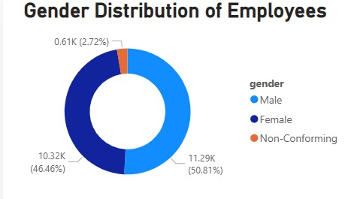
GENDER DISTRIBUTION
Insight:
Balanced gender ratio: ~51% Male,
~46% Female, ~3% NoN Conforming.
Indicates a diverse and inclusive workforce.
Suggestion:
Continue promoting inclusive policies and diversity-friendly hiring.

Slide 10
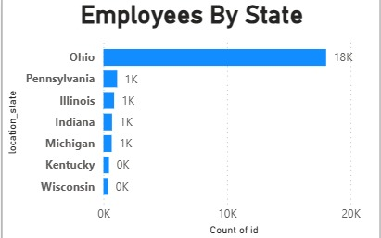
EMPLOYEES BY STATE
Insight:
Majority of employees located in Ohio; other states have limited representation.
Suggestion:
Expand hiring in other regions to balance workforce and mitigate geographic risk.

Slide 11
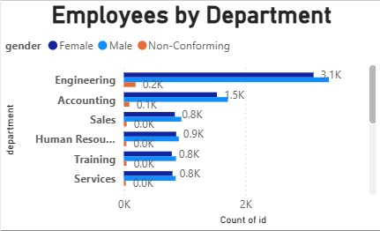
EMPLOYEES BY DEPARTMENT
Insight:
Engineering department dominates the workforce.Support functions (Training, Services, HR) have fewer employees.
Suggestion:
Invest in employee development and increase staffing in under- resourced departments.

Slide 12
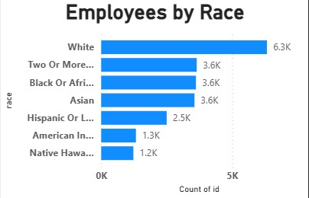
EMPLOYEES BY RACE
Insight:
Workforce primarily White (6.3K), with significant representation from other racial groups (~3.6K each).
Suggestion:
Encourage multicultural hiring programs to enhance inclusivity and innovation.

Slide 13
RECOMMENDATION
✅ Promote regional hiring expansion beyond Ohio.
✅ Strengthen training and development for smaller departments.
✅ Maintain gender balance through inclusive recruitment.
✅ Encourage diversity hiring initiatives for broader representation.
✅ Optimize remote work infrastructure to support flexible working.

Slide 14

Thank you

